Slide 1
Reducing Stroke Risk in Patients with Non-Valvular Atrial Fibrillation:
Presented by: Meredith Stogner, MNSc, APRN, AGACNP-BC, PCCN
UAMS Structural & Interventional Cardiology
A Transcatheter Approach

Slide 2
I have no disclosures.

Slide 3
Objectives
Confirm stroke risk in patients with atrial fibrillation.
Identify patients with atrial fibrillation with reason to seek non-pharmacologic alternatives to OACs
Discuss transcatheter approach to treatment of patients with atrial fibrillation with reason to seek non-pharmacologic alternatives to OAC.

Slide 4
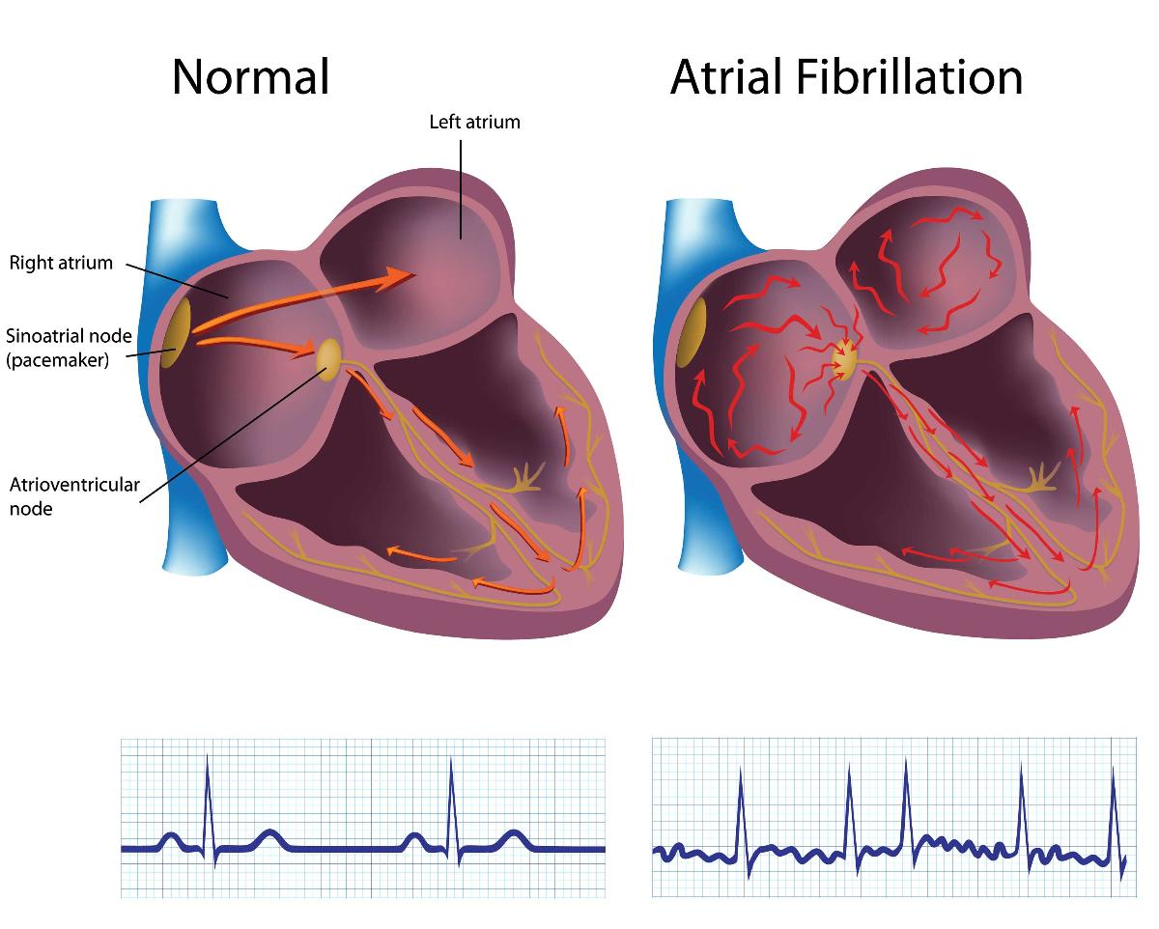
Atrial Fibrillation
Most common arrythmia
ECG:
- Irreg/Reg
- P waves replaced by fibrillatory waves
- Rate may vary
The heart & diving. (n.d.).

Slide 5
What is the big deal?
According to the CDC (2022), stroke remains the 5th leading cause of death in the U.S.
>90% of embolic strokes that originate from the heart come from the LAA (Boston Scientific. (n.d.).

Slide 6
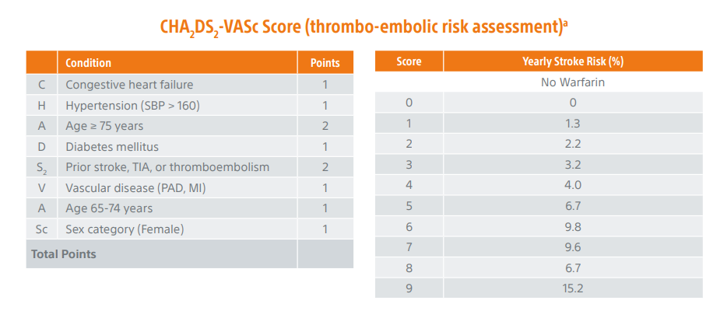
Stroke Risk Stratification
Patient screening and referral form. (2021).
Notes:
For a CHA₂DS₂-VASc score of 0 in males, 1 in females that indicates that a low risk for thromboembolic events and antithrombotic therapy may not be required; For a CHA₂DS₂-VASc score of 1 in males, higher than 1 in females, antithrombotic therapy should be considered For a CHA₂DS₂-VASc score of 2 and higher, antithrombotic therapy is usually recommended.
Lip GY et al., JAMA. 2015 May 19;313(19):1950-62 Kirchhof P, et al. Eur Heart J. 2016 Oct 7;37(38):2893-2962.

Slide 7
Rate Control Rhythm Control Stroke & Systemic Embolic event prevent
Atrial Fibrillation – Medical Management

Slide 8
But what if…
Bleeding history
High risk for bleeding
Lifestyle/Occupational risk
Drug interactions, side effects, or documented non-compliance with OAC
Hx of falls or high risk falls
Simply does not want to be on OAC

Slide 9
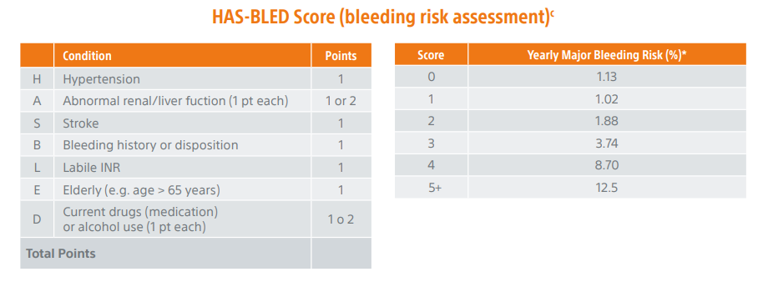
Assess Bleeding Risk
High Risk
Patient screening and referral form. (2021).

Slide 10
Possible Solution
Left Atrial Appendage
Occlusion (LAAO)

Slide 11
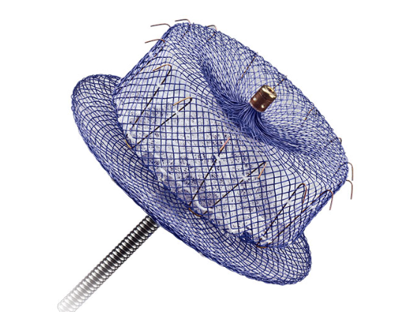
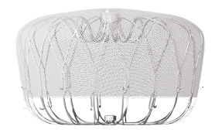
LAAO: Current FDA Approved Devices
Devices in Trial
Watchman (Boston Scientific)
Amplatzer Amulet (Abbott)

Slide 12
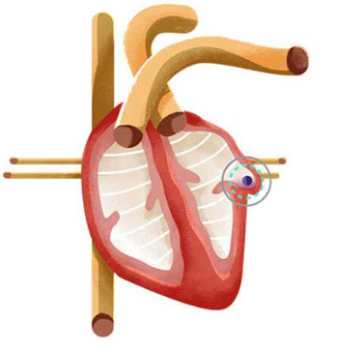
LAAO – Patient Selection
Non-valvular atrial fibrillation
Elevated stroke (CMS coverage requires CHA2DS2 –VASc score ≥ 3)
Elevated bleeding risk (HAS-BLED score = ≥3)
Able to take OAC for 6 weeks post-procedure or DAPT 6 months post-procedure
Have appropriate reason to seek non-pharmacologic alternative to OAC
Boston Scientific, (n.d.).
Notes:
LAAO is indicated for patients w/ non-valvular a-fib with elevated stroke risk (CMS coverage requires CHA2 DS2 –VASc score ≥ 3) and bleeding risk (HAS-BLED score = ≥3).
The patient should be able to take OAC for at least 45 days and/or DAPT for 6 months.
The patient should also have a need for non-pharmacologic alternative to OAC: Hx of bleeding/future bleed risk, lifestyle/occupation, drug interactions, high risk of falls, non-compliance w/ OAC, etc.
Contraindications to LAAO: Intracardiac thrombus; hx of PFO/ASD closure; appendage size unable to accommodate device; active infection; hypersensitivity to device material

Slide 13
Contraindications
Intracardiac thrombus
Hx of PFO/ASD closure
Appendage size unable to accommodate device
Active infection
Hypersensitivity to device material

Slide 14
LAAO: Procedural Information
General Anesthesia with TEE in most cases
Moderate Sedation with Intracardiac Echo (ICE) in some cases
Transfemoral approach with transeptal puncture
Major Procedural Risks: Pericardial effusion and Device thrombus
Home same day or next day
OAC for 6 weeks followed by DAPT until 6 months post-procedure
OR
DAPT for 6 months
Notes:
LAAO – Shared Decision Making
The patient must have a formal shared decision-making interaction with an independent, non-interventional provider using an evidence-based tool on OAC. This involves the non-implanting provider document agreement with procedure.

Slide 15
LAAO – Good things to know
Who performs procedure?
Structural/Interventional Cardiologist or Electrophysiologist (EP)
My biggest question from patients.
Pre-procedure testing
Notes:
Implanters vary based on facility. EP and SH/IC Cardiologists are trained to perform LAAO.
Will this help my Afib? NO IT WILL NOT. Only takes away need for OAC.
TEE or Cardiac CTA to assess LAA size and r/o thrombus. TEE may be done day of procedure.

Slide 16
Thank you!

Slide 17
References
Abbott. (2022a). Clinical insights: LAAO for reducing risk of ischemic stroke in af – clinical experience with amplatzer amulet left atrial appendage occluder. Abbptt. https://www.structuralheart.abbott/fileadmin/content/clinical-research/clinical-insights/66942_Amulet_Clinical_Insights_US.pdf
Boston Scientific. (n.d.). AF & stroke Risk | WATCHMAN Device. Www.watchman.com; Boston Scientific Corporation. Retrieved February 16, 2024, from https://www.watchman.com/en-UK-HCP/atrial-fibrillation-stroke/af-stroke-risk.html
Boston Scientific. (n.d.). WATCHMAN Clinical Trials for Physicians. Www.watchman.com; Boston Scientific. https://www.watchman.com/en-us-hcp/clinical-evidence/additional-trials.html
Hendriks, Jeroen & Heidbüchel, Hein. (2018). The management of atrial fibrillation: An integrated team approach – insights of the 2016 European Society of Cardiology guidelines for the management of atrial fibrillation for nurses and allied health professionals. European Journal of Cardiovascular Nursing. 18. 147451511880448. 10.1177/1474515118804480.
Lip GY et al., JAMA. 2015 May 19;313(19):1950-62
Kirchhof P, et al. Eur Heart J. 2016 Oct 7;37(38):2893-2962.
Kochanek KD, Murphy SL, Xu JQ, Arias E. Mortality in the United States, 2022. NCHS Data Brief, no 492. Hyattsville, MD: National Center for Health Statistics. 2024. DOI: https://dx.doi.org/10.15620/cdc:135850
Otto, C. & Bonow, R. (2021) Valvular heart disease: A companion to Braunwald’s heart disease (5th ed). Elsevier.
Patient screening and referral form. (2021). In Watchman. Boston Scientific Corporation. https://www.watchman.com/content/dam/bostonscientific/Interventional%20Cardiology/portfolio-group/Watchman/uk-dtr-website/desktop/TARs%20Patient%20Referral%20Form.pdf
Quader, N. (2023). Aortic valve disease. In T.M. Ciesielski, J.S. Sadhu, M. Husaini, & D.S. Williams (Eds.), The Washington manual: Cardiology subspecialty consult (4th ed., pp. 297-334). Walters Kluwer.
The heart & diving. (n.d.). https://dan.org/wp-content/uploads/2020/07/the-heart-and-diving-dan-dive-medical-reference.pdf

