Slide 1
Immunization for Older Adults in 2026
Kara Jones, PharmD
BOB Hopkins, MD, MACP

Slide 2
Disclosures
No financial disclosures or conflicts
Many biases, most relevant here:
FOR Science
FOR Patients
AGAINST Mis- and disinformation
AGAINST Spreading Mis- and disinformation

Slide 3
Adult Immunization 2026
Environment and Communication
Vaccination Updates
Additional Considerations

Slide 4
Environment
Challenges
Increase in vaccine hesitancy (growing since early Pandemic)
Increase in volume and politicized anti-science messaging
Increase in vaccine preventable disease [Measles, Pertussis= harbingers]
Institutionalization of anti-vaccine [and anti-science] policies
Opportunities
Trusted relationships with patients/families
Most hesitancy is not anti-vaccine. It is driven by questions/need to know.
Collaboration across science and healthcare will make us & our response stronger

Slide 5
Sources
Evidence base/Guidelines for Immunization in 2025
ACIP Guidelines remain the standard BUT…
Politicized HHS/ACIP/FDA puts this under threat
Failure to follow process is a source for confusion, doubt
Many statements NOT based on facts
Attacks on mRNA, COVID vaccination are likely just ‘step 1’…
March 2026: injunction by Federal Court of Massachussetts [Return to 2/2025]
April 2026: New ACIP Charter released by HHS
Vaccine Integrity Project, National Adult and Influenza Summit
Working with medical specialty societies, states and insurers to provide E-B guidance

Slide 6
Making Vaccine Recommendations
Clinical team ‘on same page’
Strong presumptive recommendation AND WHY
Hesitancy most commonly = Questions
Pivot to respectful conversation [Brief Motivational Interview]:
Engage, establish trust
Understand what matters
Offer information
Clarify and accept patient decision
If end today without vaccine= revisit next time [NOT a failure!]
https://pubmed.ncbi.nlm.nih.gov/39187772/

Slide 7
Vaccine updates and emphases
“Core Vaccines”
Influenza
COVID-19
RSV
Hepatitis B
Pneumococcal
Shingles
Reemerging diseases:
MMR, Pertussis, Polio
Less Common:
HAV, Mpox, Meningococcal

Slide 8
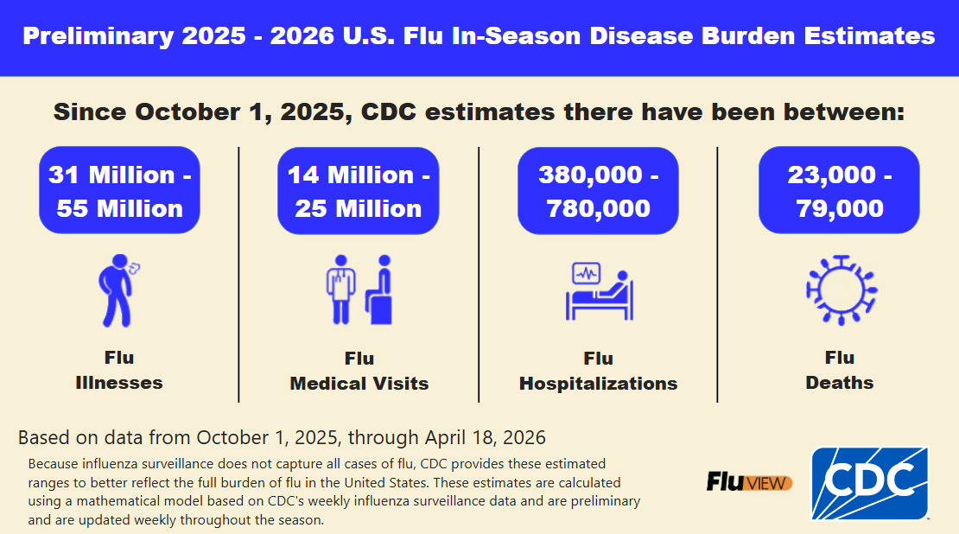
Influenza (Flu)
Preliminary Estimated Flu Disease Burden 2025-2026 Flu Season | Flu Burden | CDC.
www.cdc.gov/flu-burden/php/php/data-vis/2025-2026.html

Slide 9
Influenza
Few understand personal risk, many think ‘any URI/LRI is a ‘flu’
Vaccine effectiveness varies in individuals.
Timing
Vaccine’ immune response
Match between circulating and vaccine strains
Primary vaccine benefit is reduction in severe disease
ANY benefit much greater than ZERO protection with no vaccination
Sore arm, malaise, achiness +/- fever are common post-vaccination symptoms
NO common severe adverse effects.
https://pubmed.ncbi.nlm.nih.gov/39197095/
https://pmc.ncbi.nlm.nih.gov/articles/PMC9861815/
Notes:
Triple A- AAA

Slide 10
Influenza Vaccination: Everyone 6 months+, annually
All vaccines TRI-valent in 2025-26 [A-H1N1, A-H3N2 (new), B-Victoria]
Multiple vaccine types, single dose syringes*: 1 dose IM annually
Any vaccine which is indicated for patient [age, medical conditions] may be used
HD/Adjuvanted/Recombinant preferred for persons aged 65+
HD/Adjuvanted is an option in transplant recipients aged 18+
When to vaccinate:
As soon as vaccine is available:
Children
Women in late 2nd-3rd trimester pregnancy
Individuals not likely to return for vaccination later in season
Mid-Sept or later: older adults, immune compromised, adults with risk factors
Continue to immunize unvaccinated persons as long as virus is circulating
https://pubmed.ncbi.nlm.nih.gov/39197095/
Notes:
ecause the B/Yamagata virus has not been detected globally since March 2020, the WHO and CDC recommended removing it to streamline vaccine production, making trivalent vaccines the standard in the US beginning in the 2024–2025 season.

Slide 11
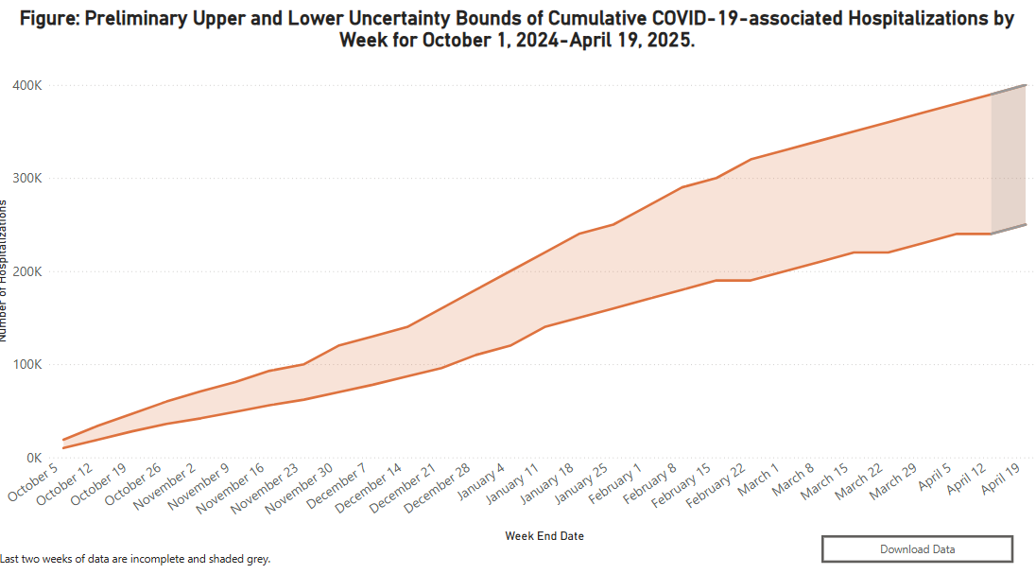
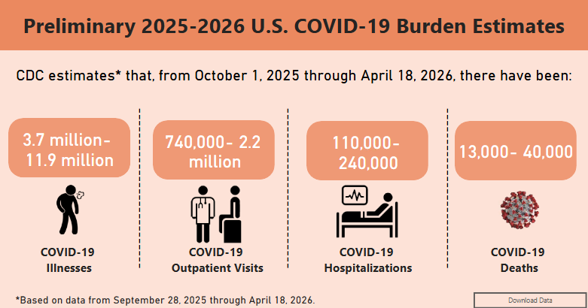
COVID-19
Most hospitalizations and deaths are in persons 65 and older…
www.cdc.gov/covid/php/surveillance/burden-estimates.html;
www.cdc.gov/covid/vaccines/benefits.html

Slide 12
COVID-19
There has been a decline in overall M&M from 2020-present
Greatest impact: AGE before risk factors…
Highest risk: Persons 75+, persons 65-74 and <4, immune compromised, risk groups
Ongoing infections [virus transmission] drives viral evolution
Year-round disease with Semi-annual disease peaks (somewhat variable timing)
Continued decline in severity of illness IS NOT guaranteed
Vaccines
ARE reactogenic, but severe adverse events are rare, myocarditis in young men is most common
Primary benefit is reduced severity of disease
Lesser (lasting months) reduction in infection risk
Reduce likelihood of PASC/Long COVID
https://www.cdc.gov/acip-recs/hcp/vaccine-specific/covid-19.html

Slide 13
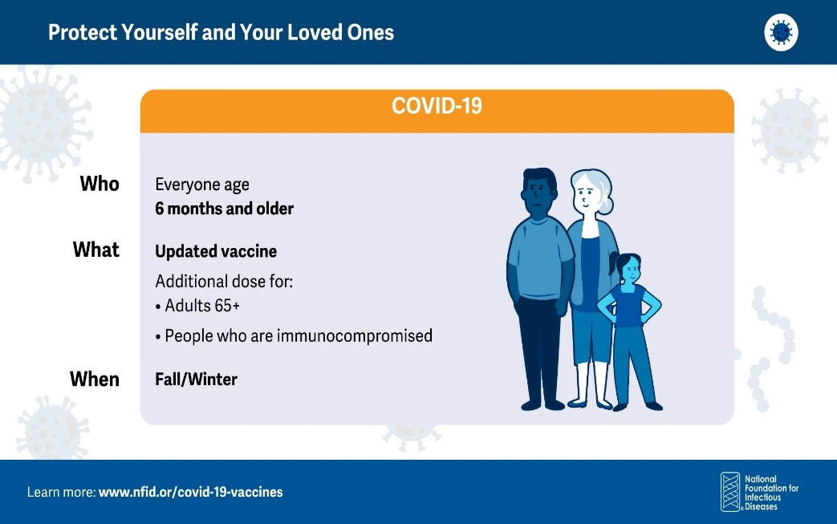
COVID-19:
Adult Vaccination Recommendation:
Vaccination during pregnancy (risk reduction for mom and baby) Increased-risk condition
2 doses each year in adults 65+
2 or more doses/year in immunocompromised
Vaccines 2025-26:
mRNA Original M, P; 2nd Gen M LP.1.8.1
Protein Subunit N JN.1
No timeline (yet?) for next vaccine update…
www.cdc.gov/covid/hcp/vaccine-considerations/overview.html
https://link.springer.com/article/10.1007/s40264-024-01458-w
https://publications.aap.org/pediatrics/article/153/3/e2023064252/196616?autologincheck=redirected&utm_source=TrendMD&utm_medium=TrendMD&utm_campaign=Pediatrics_TrendMD_1
https://www.nature.com/articles/s41467-024-47745-z
https://jamanetwork.com/journals/jamanetworkopen/fullarticle/2818033
https://jamanetwork.com/journals/jama/fullarticle/2814537

Slide 14
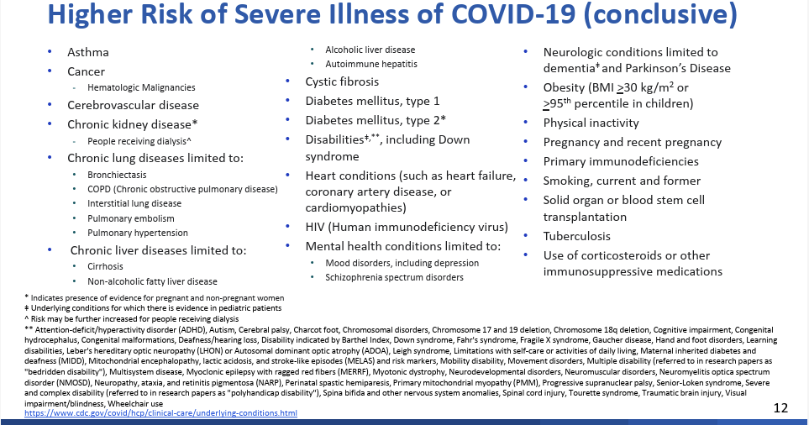
https://www.cdc.gov/acip/downloads/slides-2025-04-15-16/05-Panagiotakopoulos-COVID-508.pdf

Slide 15
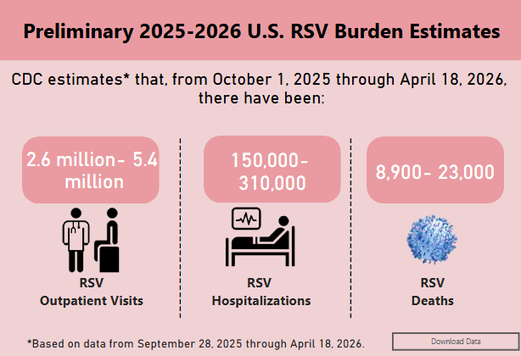
RSV Disease 2024-2025
How can we reduce the impact of severe RSV?
Vaccines for adults:
3 vaccine products [2 protein subunit[PS],1 mRNA]
1 dose IM [One and Done]
Reactogenic [Arm pain, Fever, Malaise]
Uncommon severe AE [GBS <10 cases/million doses PS]
Long-Acting Monoclonals for infants:
2 products [nirsevimab, clesrovimab*]
September-April: all infants <8 months, 1st RSV season
Best given before discharge from nursery
No common AE
Highest risk [heart, lung dz] in second RSV season
https://www.cdc.gov/rsv/php/surveillance/
https://jamanetwork.com/journals/jamanetworkopen/fullarticle/2826104#
Notes:
Testing critical to distinguish RSV
Lack of antiviral medications makes immunization more important
CDC estimates* annual US impact of RSV disease
2.1M Outpatient visits among children < 5 years
58-80K Hospitalizations among children < 5 years
100-150K Hospitalizations among adults 65+ years

Slide 16
RSV
Common cause for fall/winter illness/M&M, worst at extremes of age
#1 Cause of Pneumonia in children <2 years
Causes thousands of deaths and 10-thousands hospitalizations in older adults
Cannot reliably distinguish from other LRTI without testing
No available effective antivirals
Lifespan vaccination strategy to mitigate impact of RSV disease
Infants [Maternal immunization or Long-acting monoclonal]
Pregnant women [Passive antibody transfer to infants]
At-risk adults 50+ years*
ALL adults 75 years+
https://www.cdc.gov/acip-recs/hcp/vaccine-specific/rsv.html
https://www.cdc.gov/acip/vaccine-recommendations/index.html

Slide 17
RSV Vaccines: Effectiveness and Safety
Vaccine effectiveness [real world]
VISION Network: 28271 RSV hosp, 36521 ED visits in adults 60+ 10/23-3/24
77% VE against RSV-associated ED visits
No IC: 80% VE vs. RSV hospital admit, 81% vs. RSV ICU admit/death/both
IC: 73% VE vs. RSV hospital admit, 81%
VA: 146852 vaccinated v 582936 controls, median 75.9 years
VE 78.1% RSV illness, 78.7% v. RSV ED/UC visits, 80.3% v. RSV Hospitalization
Vaccine safety
V-Safe, VAERS
Reactogenic: Pain, swelling, HA, Fatigue, Arthralgia, Redness= common AE
GBS reporting rate elevated [4.4, 1.8/million doses P and GSK vaccine]
FDA/CMS Collaboration: Self-controlled case series CMS data
>3.2 million adults 65+: < 10 cases GBS/1 M doses either subunit vaccine
www.thelancet.com/journals/lancet/article/PIIS0140-6736(24)01738-0/fulltext
www.thelancet.com/journals/laninf/article/PIIS1473-3099(24)00796-5/fulltext
www.cdc.gov/mmwr/volumes/73/wr/mm7321a3.htm
www.medrxiv.org/content/10.1101/2024.12.27.24319702v1

Slide 18
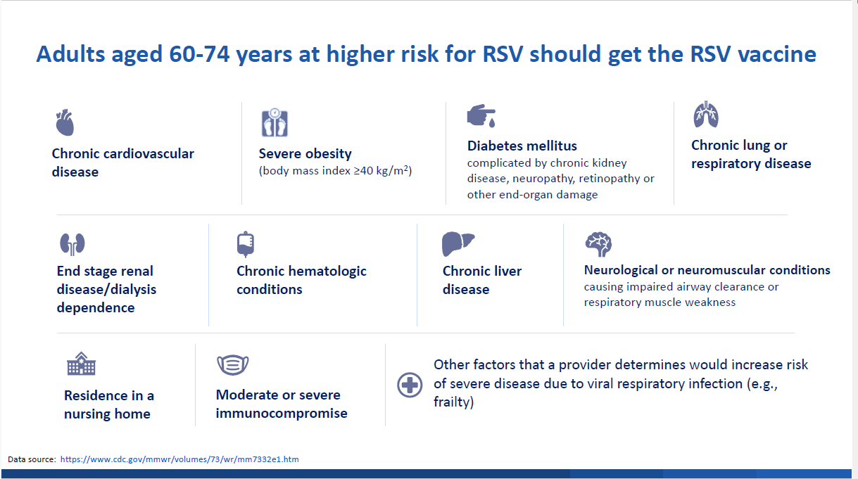
RSV Risk Mitigation: 1 DOSE for adults…
ALL Adults 75 years and older
Adults 50*-74 years
AT HIGHEST RISK
50
*rfkjr/HHS signed off on April ACIP vote for RSV vaccine at age 50 on 6/29/2025 (as no incumbent CDC director)
www.cdc.gov/mmwr/volumes/73/wr/mm7332e1.htm#B1_down
https://www.cdc.gov/acip/vaccine-recommendations/index.html

Slide 19
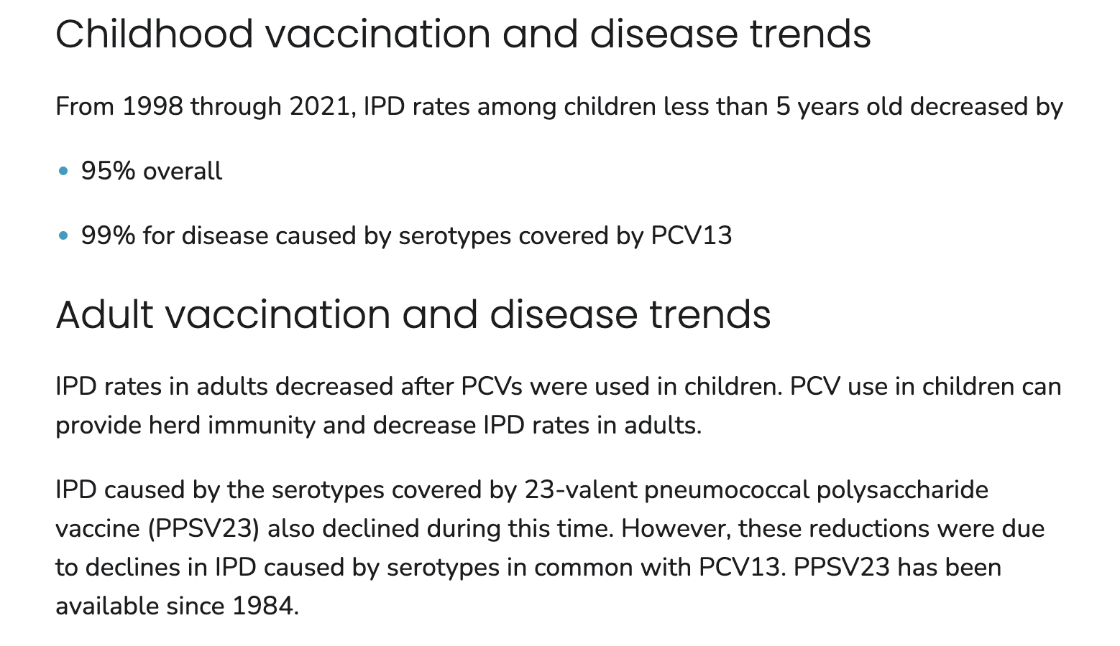
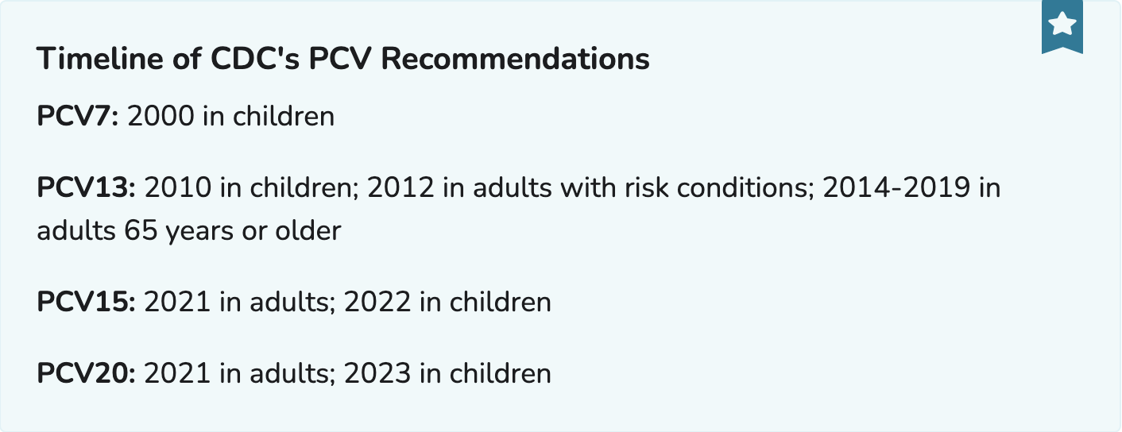
Pneumococcal Disease and Vaccination
www.cdc.gov/pneumococcal/php/surveillance/index.html

Slide 20
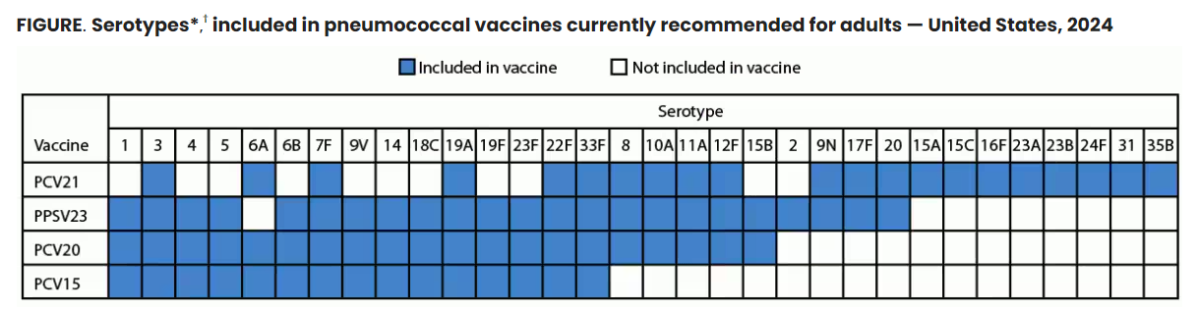
Adult Pneumococcal Vaccines: PCV21 = PCV20 +1
https://www.cdc.gov/mmwr/volumes/73/wr/mm7336a3.htm
https://pubmed.ncbi.nlm.nih.gov/32798216/

Slide 21
Pneumococcal
Pneumococcal recommendations for adults and children are diverging
Serotypes causing invasive disease differ in children vs. adults
For most adults, PCV21 better covers strains causing IPD than PCV20 or PCV15+PPSV23
Homeless, native American [AK, Navaho] + certain Western states serotype 4 causes >30% IPD. Serotype 4 is NOT in PCV21. [PCV20 or PCV15+PPSV23 are preferred]
Pneumococcal vaccination is recommended for all adults at risk:
Adults 18-49 with immune compromising conditions
Adults 18-49 with increased risk medical conditions
ALL Adults 50+ [recommended 10/2024]
PneumoRecs App [FREE web and phone apps]
https://www.cdc.gov/pneumococcal/hcp/vaccine-recommendations/app.html

Slide 22
Adult Pneumococcal Recommendations
Adults 19-49 years
INCREASED RISK MEDICAL Conditions:
Alcoholism
Cigarette Smokers
Diabetes Mellitus
Heart Disease
[Incl. CAD, CHF; NOT Isolated HTN]
Liver Disease
Lung Disease
[Incl. Asthma, COPD]
Adults 19-49 years
HIGHEST RISK MEDICAL Conditions:
1. IMMUNE COMPROMISE:
Medications (Prednisone >20/d, Biologics, ...)
Cancer and Cancer Treatment
Transplants [Organ, BMT, Stem Cell]
Inherited/Acquired Immune Deficiency
Sickle Cell, Splenectomy
Severe CKD/ESRD,
Nephrotic Syndrome
2. ANATOMIC RISKS:
CSF Leaks, Cochlear Implants
Adults 50+ years
AT HIGH RISK due to AGE
Applies to ALL 50 years and older
Why?
Immune senescence
High proportion have risk conditions
[Far fewer patients understand ^^ risk]
No adult PCV: Give PCV21, PCV20 or PCV15+PPSV23
Prior adult PCV: Number of doses, timing/specifics vary
depending on risk factors, vaccination history
Use PneumoRecs Vaccine Advisor…
https://www.cdc.gov/acip-recs/hcp/vaccine-specific/pneumococcal.html

Slide 23
Zoster/Shingles
Zoster risk increases with age and with immune compromise
Zoster complications: post-herpetic neuralgia [PHN] most common
Vaccine: 2 doses at 2*-6 months, reactogenic.
Recommended in all unimmunized adults 50+
Including adults 50+ who received live-attenuated Zoster vaccine
Recommended in adults 18+ with immune compromise
Serious adverse events uncommon. GBS reported, 3 excess cases/million doses
Emerging data on reduction of dementia, stroke, coronary events…
https://publications.aap.org/pediatrics/article/144/1/e20182917/76826/Incidence-of-Herpes-Zoster-Among-Children-2003
https://publications.aap.org/pediatrics/article/144/1/e20183561/37086/Varicella-Vaccine-What-Have-You-Done-for-Me-Lately
https://jamanetwork.com/journals/jamanetworkopen/fullarticle/2835162

Slide 24
Re-Emerging Diseases
Decline in childhood and adult vaccination rates results in lower community [Herd] immunity.
Places ALL of us at risk
Particularly older adults (immune senescence)
Impact will be felt unevenly-
Immune Compromised incur greater risk
Communities with low rates impacted most

Slide 25
Tdap and Pertussis
Tetanus and Diphtheria = very rare in US
Pertussis: highly contagious bacterial/toxin mediated illness
Classic illness ‘100 days cough’ in children/adolescents/adults
Rarely causes death EXCEPT in neonates/infants
Antibiotics stop contagion but not symptoms…
Vaccination is best tool for prevention but imperfect …declines with time
Reporting is passive, so likely underestimates impact
2024: 6-fold+ increase from 2023, highest case count since 2019
2025: 6,600 cases by 5/1/25 [4x same date 2024]
2026: Continued increase in cases, infant deaths…
https://www.cdc.gov/pertussis/hcp/vaccine-recommendations/index.html
https://www.cdc.gov/acip-recs/hcp/vaccine-specific/dtap-tdap-td.html
https://www.cdc.gov/pertussis/php/surveillance/index.html

Slide 26
Tdap Vaccination Recommendations
Childhood vaccination with Dtap [Components same, proportions differ]
Adolescent Tdap at 11-12 years
Tdap for pregnant women [27-36 weeks] every pregnancy
Passive antibody transfer to protect neonate
Tdap every 10 years for adults [Should have received primary series]
For ‘dirty wound’ Tetanus prophylaxis- 5 years
Reactogenic vaccine: arm pain, redness, malaise common
No common serious AE
https://www.cdc.gov/acip-recs/hcp/vaccine-specific/dtap-tdap-td.html

Slide 27
MMR
Measles resurgent in 2025- highest since Measles declared eliminated in 2000
Most cases imported by unvaccinated/under-vaccinated US travelers
MMR is safe and highly effective live-attenuated vaccine [93-97% effective]
Should not be given in pregnancy or immune suppression
All adults born after 1957 should be immunized with [1+ doses] MMR
Adults in risk groups [including HCP] need vaccination unless immune
Routine infant vaccination with MMR starts at 12 months
MMR is recommended for ALL unvaccinated US travelers > 6 months of age who are not pregnant or immune suppressed
Vaccinate vs titer…
https://www.cdc.gov/measles/data-research/index.html

Slide 28
Polio
Imported case-linked outbreak in NY/NJ in 2022, 1 paralytic case
US only uses inactivated vaccine [IPV] since 1990’s
Most worldwide disease now is VAPP [Vaccine-Associated Paralytic Polio]
Reversion to virulence of LAIV OPV strains
1 dose IPV recommended for persons in outbreak or travel to at-risk destination
Travel warnings for many countries -including a few in EU- due to Polio cases…

Slide 29
Less-Common Senior Vaccinations

Slide 30
Hepatitis A Vaccination
Recommended for ALL children [May 2006, Catch up 6/2019]
Homelessness added as an indication [2019]
Updated risk-based adult recommendation [July 2020]
Ongoing outbreak assoc. with homelessness, drug use
Clotting factor recipients, daycare and food service workers removed
Inactivated vaccines: HAV 2 doses [6 months] or combined HAV/HBV 3 doses* [6 mo] Provides >90% long-term immunity to HAV
Adult HAV ROUTINE Indications:
Anyone who desires vaccination/vaccine protection
Adult HAV Risk-Based Indications:
Chronic Liver Disease [including chronic elevation of transminases w/ and w/o Dx] HIV
Homelessness MSM
Drug users (Injection and Non-injection) Travelers to ‘at risk’ destination
Residents, staff @ high-risk settings (prison, developmental disability) Lab workers at risk
https://www.cdc.gov/mmwr/volumes/68/wr/pdfs/mm6806a6-H.pdf
Notes:
Limited data: lower immune response in persons vaccinated after age 40, slower development of immunity in obese vaccine recipients

Slide 31
Hepatitis B
Routine recommendation for everyone to age 59 years
Risk-based recommendation for all persons 60+
Vaccine response
greatest in infants/children, begins to decline starting in 40’s
Medical conditions [and duration of medical conditions] affects immune response as well
Vaccines: Standard, HD/IC, Polyvalent, TLR-9 Adjuvanted, Combined HAV/HBV
For all but TLR-9 Adjuvanted: 3 doses at 0, 1 mo, 6 mo [and alternate schedules…]
TLR-9 Adjuvanted: 2 doses at 1 month interval
Serology is used to assess immunity [surrogate of protection] but primary immunity is cell mediated [which is not easily measured].

Slide 32
Hepatitis B: Adults >60 years
Adults 60+ without risk factors MAY be vaccinated to prevent hepatitis B
Behavioral and social:
>1 sex partner in 6 months
People seeking STD evaluation or treatment
Household contacts and sexual partners of HBsAg+ people
MSM
IVDU [current or recent]
Incarcerated persons
Occupational
Health care, public safety workers, staff working with developmentally disabled
Medical
Persons with Diabetes mellitus at MD discretion
Persons with (any) chronic liver disease
[incl. HCV, cirrhosis, NASH/fatty liver, alcoholic liver dz, autoimmune hepatitis, ^ transaminases]
Persons living with HIV
Dialysis patients (Hemo- and Peritoneal) and ESRD patients pre-dialysis
International Travel: destination with endemic HBV (community prevalence > 2%)
https://www.cdc.gov/mmwr/volumes/71/wr/mm7113a1.htm
Notes:
Hepatitis B vaccination recommendation in adults was based on risk until recently.
Risk groups made up ~60% adults yet despite universal childhood recommendation, transmission continued…

Slide 33
Challenges in Hepatitis B vaccination
Response to standard Hepatitis B vaccines lower in patients with:
Obesity
Diabetes Mellitus [more so with longer duration of disease]
Renal failure
Increasing age
Immune compromising conditions
Standard vaccines:
>90 % response rate for vaccination in adults < 40 years
~75% response rate for vaccination of adults at 60 years
ACIP does not recommend a specific vaccine product for HBV immunization except immune compromise, hemodialysis ‘Standard vaccines’ v. TLR-Adjuvanted
STD: 3 doses at 0, 1, 6 mo
Renal/IC Dose: 3 doses at 0,1, 6 mo Titers…
Adjuvanted: 2 doses at 0, 1 mo
https://www.cdc.gov/mmwr/volumes/67/rr/rr6701a1.htm

Slide 34
MPox
Jynneos: Recommendation in anyone 18+ who is at risk
2 doses at 1 month interval
Same vaccine now recommended for smallpox
Ongoing outbreaks in Africa with spillover into Europe and beyond…
Indications:
Persons who are gay, bisexual, MSM, transgender or nonbinary who have had any of the following in the past 6 months or anticipate any of the following:
1 new STD
>1 sexual partner
Sex at a commercial venue
Sex in association with large public event in area where MPox is occurring
Sexual partners of persons in any of these groups
No current ACIP recommendation in pregnancy.
Not recommended routinely for potential occupation exposure in HCW except in rare circumstance (i.e. no PPE available).
www.cdc.gov/vaccines/acip/meetings/downloads/slides-2023-10-25-26/04-MPOX-Rao-508.pdf

Slide 35
Meningococcal: Risk based recommendations for adults
Anatomic/Functional asplenia [incl hemoglobinopathy/SS], HIV infection, Persistent complement component deficiency or complement inhibitor treatment (Ecluzumab, Ravulizumab) 2 doses Men ACWY @ 8 week interval, revaccinate every 5 years as long as risk persists AND
2-3 doses Men B vaccine (depends on vaccine product) OR Men ABCWY may be substituted
Microbiologists routinely exposed to Meningococcus 1 dose Men ACWY and revaccinate every 5 years as long as risk persists AND
2-3 doses Men B vaccine (depends on vaccine product) OR Men ABCWY may be substituted
First year college students in residential housing (dorm) or military recruit not vaccinated at 16+ years 1 dose Men ACWY
Travelers to areas endemic or hyperendemic for Meningococcus 1 dose Men ACWY and revaccinate every 5 years as long as risk persists
New Pentavalent Meningococcal Vaccines give us simpler options!
Delay Men B until after pregnancy unless increased risk and vaccination benefits outweigh potential risks.
cdc.gov/mmwr/volumes/69/rr/rr6909a1.htm

Slide 36
HPV: Cancer Prevention Success
Critically important CANCER PREVENTION vaccine
Genital Cancers and precancers
Oropharyngeal Cancers
HPV-associated genital verruca (warts)
Despite dramatic cancer reductions with sustained high vaccination rates… struggles continue
Greatest benefit: Vaccination before HPV exposure
Recommended for:
ALL 9-26 years
Start series before 15, No IC: 2 doses at 6 months+ interval
Start series at 15+ and/or IC: 3 doses at time 0, 1-2 mo, 6+ months
SHARED DECISION MAKING for persons 27-45 years

Slide 37
Travel Vaccines (sooner is better than later!)
Whole topic unto itself…
Keys: Know details of itinerary Quality of travel companies’ recommendations varies tremendously…
Discuss medical history and risk-tolerance of travelers
Plan and vaccinate well ahead of travel
‘Salvage’ (i.e. last minute) recommendations nearly always inferior to planned…
Use up-to-date resources to make recommendations [including travel alerts]
CDC Travel Site is very useful
https://wwwnc.cdc.gov/travel

Slide 38
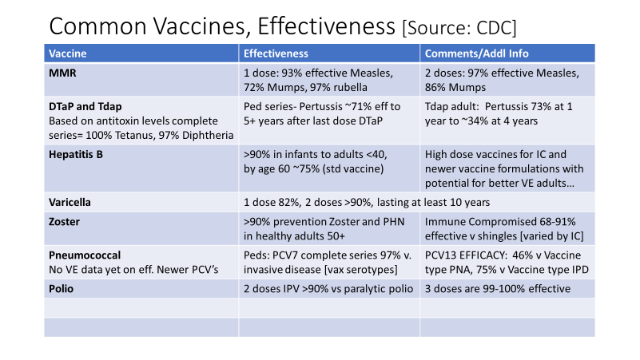
Effectiveness of Common Vaccines
Vaccine | Effectiveness
Polio | Paralytic disease: 2 doses >90%; 3 doses 99-100%
MMR | 1 dose: measles 93%, mumps 72%, rubella 97% 2 doses: measles 97%, mumps 86%
DTaP | Pertussis in children: 71% ≥5 yr after last dose
Tdap | Pertussis in adults: 73% after 1 yr, ~34% after 4 yr
Hepatitis B | Infant to adults: >90% By age 60 yr, standard dose: ~75%
Varicella | 1 dose: 82%; 2 doses: >90%, lasting at least 10 yr
Zoster | Shingles and PHN in healthy adults ≥50 yr: >90% Shingles in individuals who are immunocompromised: 68-91%
Pneumococcal | PCV7 series vaccine-type IPD in children: 97% PCV13: 45% against vaccine-type pneumonia, 75% against vaccine-type IPD
www.cdc.gov/vaccines/hcp/by-disease/index.html
Notes:
Here is some data on the effectiveness of a number of important vaccines we use every day in the US to protect adults and/or children.
IPD, invasive pneumococcal disease; PCV pneumococcal conjugate vaccine; PHN, postherpetic neuralgia.

Slide 39
Vaccine Coverage and Access
Private insurance: All ACA compliant plans must cover vaccines for ACIP approved indications
BUT: Some individuals carry Limited benefit plans= ‘Junk Insurance’
BUT: Must be administered by ‘participating provider’ to be covered
BUT: Travel vaccines generally NOT covered
BUT: New vaccine products MAY BE excluded until the next plan-year after the recommendation published
Medicare: No copay for ACIP-approved indications ‘within restrictions of statute’
Influenza, COVID-19, PCV/PPS, Tdap [Injury-associated ONLY] covered under PART B. [Medical Office]
RZV, RSV, Tdap [Preventive] covered under PART D. [Participating Pharmacy, practices using intermediary; but no Hospital-based Clinics]
Medical indication [Mpox, HBV, HAV, MMR, VAR] can be covered w/ICD-10 indic.; travel vaccines not covered
Medicaid: ACIP recommended vaccines Covered as of 10/31/2023 BUT…
Reimbursement MAY NOT be sufficient to cover cost of vaccines and vaccine administration…
Generally ONLY covered in medical office - - - NOT in Pharmacy…

Slide 40
Thank you for your time and attention!!

